Slide 1
Titanic Survival Prediction Using Machine Learning
Submitted in the partial fulfillment for the award of the degree of
BACHELOR OF ENGINEERING
IN
BUSINESS SPECIALIZATION IN CSE
Submitted by-
Navya Arora (19CBS1027)
Sparsh Phutela (19CBS1016)
Lakshay Lamba (19CBS1035)
Chandrashekhar Kumar (19CBS1041)
Saquib Nazar(19CBS1011)
Under the Supervision of:
DR RAJEEV KUMAR
Department of AIT-CSE
DISCOVER . LEARN . EMPOWER

Slide 2

TITANIC SURVIVAL

Slide 3
Outline:-
Introduction to Project
Problem Formulation
Objectives of the work
Methodology used
Results and Outputs
Conclusion
Future Scope
References

Slide 4
Introduction to the Project:-
We will be understanding, how to analyze and predict, whether a person, who had boarded the RMS Titanic has a chance of survival or not, using Machine Learning’s Logistic Regression model.
Brief description about Logistic Regression:
A simple yet crisp description of Logistic Description would be, “it is a supervised learning classification algorithm used to predict the probability of a target variable. The nature of target or dependent variable is dichotomous, which means there would be only two possible classes
The graph of logistic regression is as shown below:
Let’s Dive into the process..!! :
Now let us begin the main part of this article.
Or you can use both as supplementary materials for learning about machine learning!
For better understanding, let’s split the task into smaller parts and depict them in a workflow as shown below :
As we now know what we have to do, to accomplish this task, we shall begin with the very first and the most important thing needed in machine learning, a Dataset.
What is a dataset:
A data set, as the name suggests, is a collection of data. In Machine Learning projects, we need a training data set. It is the actual data set used to train the model for performing various actions.
Here, in this case, we will be using a dataset available on the internet. One can find various such datasets over the internet.
The dataset that I’ve used in my code was the data available on Kaggle.
One thing must be kept in mind, the larger the data, the more we can train our model, and the more accurate our results come out to be. Don’t worry if all of this sounds weird to you, it will all make sense in a few minutes.

Slide 5


Slide 6
Advantages:-
Logistic Regression is one of the simplest machine learning algorithms and is easy to implement yet provides great training efficiency in some cases. Also due to these reasons, training a model with this algorithm doesn't require high computation power.
The predicted parameters (trained weights) give inference about the importance of each feature. The direction of association i.e. positive or negative is also given. So we can use logistic regression to find out the relationship between the features.
This algorithm allows models to be updated easily to reflect new data, unlike decision trees or support vector machines. The update can be done using stochastic gradient descent.
Logistic Regression outputs well-calibrated probabilities along with classification results. This is an advantage over models that only give the final classification as results. If a training example has a 95% probability for a class, and another has a 55% probability for the same class, we get an inference about which training examples are more accurate for the formulated problem.
In a low dimensional dataset having a sufficient number of training examples, logistic regression is less prone to over-fitting.
Rather than straight away starting with a complex model, logistic regression is sometimes used as a benchmark model to measure performance, as it is relatively quick and easy to implement.
Logistic Regression proves to be very efficient when the dataset has features that are linearly separable.
It has a very close relationship with neural networks. A neural network representation can be perceived as stacking together a lot of little logistic regression classifiers.
Due to its simple probabilistic interpretation, the training time of logistic regression algorithm comes out to be far less than most complex algorithms, such as an Artificial Neural Network.
This algorithm can easily be extended to multi-class classification using a softmax classifier, this is known as Multinomial Logistic Regression.
Resultant weights found after training of the logistic regression model, are found to be highly interpretable. The weight i can be interpreted as the amount log odds will increase, if x_i increases by 1 and all other x's remain constant. i here refers to any training example from i = 0 to n .

Slide 7
Problem Formulation:-
Compile time errors may occur.
Not choosing a right tool.
Problem may arise during installation of latest version of pycharm and importing libraries and files (like pygame, Mixer, Math).
Syntax errors and Run time errors may occur.
Problem may arise during Debugging.
Problem may arise during the back ground setting by loading proper .PNG extension image

Slide 8
Objectives:-
Titanic Survival Prediction Using Machine Learning
This project is to replicate the core a machine learning project based. We will be using logistic regression in this project. Basically, the prediction would play a major role in it. We would be learning some library files and much more. We will be understanding, how to analyse and predict, whether a person, who had boarded the RMS Titanic has a chance of survival or not, using Machine Learning’s Logistic Regression model.
Hey folks, in this article, we will be understanding, how to analyse and predict, whether a person, who had boarded the RMS Titanic has a chance of survival or not, using Machine Learning’s Logistic Regression mode.
The project name is Titanic Survival Prediction Using Machine Learning. which is very interesting. AS nowadays many of the machine learning is more popular . In this project I will go through the whole process of creating a machine learning model on the dataset provide .this provides information on the fate of passengers through dataset, summarized according to economic status (class), sex, age and survival. So,
Firstly, for that we have surfed on the internet and some books. for this we needed to learn the language named python not in so much deep but some of the basic stuff which includes the syntax as well as loop the most important. So, for that we watch some of the videos on the youtube for it and also study some books for practice. It took approximately week depends upon our capable
.

Slide 9
Methodology used:-
SOME TECHNICAL WORK INFORMATION IS AS FOLLOWS-
Use of the ANACONDA PLATFORM which is the fastest platform for running python language as well as contains all the packages which is to be used in machine learning.
The following methodology will be followed to achieve the objectives defined for proposed research work-
Jupyter notebook is the open source web application use to document the text as well as write the code. Moreover, we can write our own text ,upload images of it .
Use of the logistic regression algorithm. It is used to predict the output of the two classes .example- fail/pass, win/loss.
Use of the linear regression instead of the linear equation. Linear equation is basically an equation of two variables which gives a straight line wheras regression is the prediction of output on a continuous spectrum.
Use of sigmoid function which is equal to 1/1+e ^ -(b1+b2x).it basically gives the probability .
Use of threshold values to predict the situation. Hence, this is suited for classification model.
Importing library files such as pandas for plotting ,loading the datasets to database, numpy for numeric analysis and seaborn for data visualization and much more .
Representation of data in form of confusion matrix .
sckit learn tool for prediction of data analysis used in training and testing the model.
Concept of feature engineering.

Slide 10
Results and Outputs:-
Our goal for this project is to replicate the core a machine learning project based. We will be using logistic regression in this project. Basically, the prediction would play a major role in it. We would be learning some library files and much more. We will be understanding, how to analyse and predict, whether a person, who had boarded the RMS Titanic has a chance of survival or not, using Machine Learning’s Logistic Regression model.
Hey folks, in this article, we will be understanding, how to analyse and predict, whether a person, who had boarded the RMS Titanic has a chance of survival or not, using Machine Learning’s Logistic Regression mode.
A simple yet crisp description of Logistic Description would be, “it is a supervised learning classification algorithm used to predict the probability of a target variable. The nature of target or dependent variable is dichotomous, which means there would be only two possible classes.” as stated in the tutorial points .

Slide 11
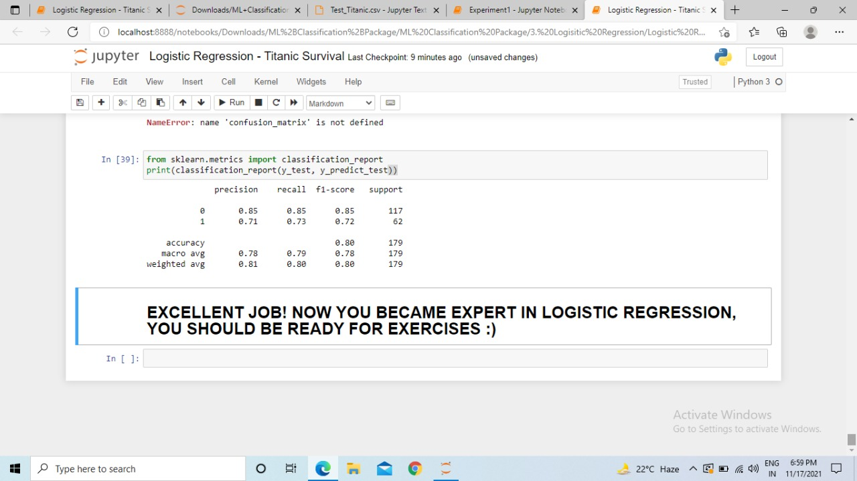

Slide 12
Conclusion:-
Our goal for this project is to replicate the core a machine learning project based. We will be using logistic regression in this project. Basically, the prediction would play a major role in it. We would be learning some library files and much more. We will be understanding, how to analyse and predict, whether a person, who had boarded the RMS Titanic has a chance of survival or not, using Machine Learning’s Logistic Regression model.
Hey folks, in this article, we will be understanding, how to analyse and predict, whether a person, who had boarded the RMS Titanic has a chance of survival or not, using Machine Learning’s Logistic Regression mode.
A simple yet crisp description of Logistic Description would be, “it is a supervised learning classification algorithm used to predict the probability of a target variable. The nature of target or dependent variable is dichotomous, which means there would be only two possible classes.” as stated in the tutorial points .

Slide 13
Future Scope:-
Understand theory behind logistic regression
Apply sigmoid function to obtains probability
Load data set from a CSV file using panda data frame
Develop function in python and apply it panda frame work
Plots several plots using seaborn library such as plots, histograms, ,heat maps
Fill out missing data points (null elements)
Convert categorical variables to dummy variables
Divide data set into training & testing using scikit-learn
Train logistic classification model using scikit learn
Evaluate model & present result using classification reports

Slide 14
References:-
You tube Videos
GeeksforGeeks for python language,
J. F. Islam, M. Mondal, and C. K. Roy, “Bug Replication in Code Clones: An Empirical Study,” in 2016 IEEE 23rd International Conference on Software Analysis, Evolution, and Reengineering (SANER), 2016, pp. 68–78.
C. K. Roy, M. F. Zibran, and R. Koschke, “The vision of software clone management: Past, present, and future (Keynote paper),” in 2014 Software Evolution Week - IEEE Conference on Software Maintenance, Reengineering, and Reverse Engineering (CSMR-WCRE), 2014, pp. 18–33.

Slide 15


